Slide 1
IET-DAVV STUDY MATERIALS
Now Easy to find study materials

Slide 2
IET-DAVV STUDY MATERIALS
Bachelor of Engineering
Computer Engineering & Information Technology
(Session 2021-2022)
Guided By:-
Dr. G.L. Prajapati
Submitted By:-
Lokesh Nargesh (19I7029)
Madhur Jatiya (19I7030)
Rani Ahire (20C7084)

Slide 3
Contents
Introduction
Problem Statement
Expected Output
Databases and Technology Uses
Software and Server
Supported Devices
System Requirements
Screenshots and Explanation
References

Slide 4

Introduction
IET~DAVV STUDY MATERIAL is a website which provides free study materials to IET Students.
Student can download as well as upload old Paper, Notes and Books from our website.
It can be accessible by any devices connected with the Internet.
All Study Materials of IET are available on a single platform.

Slide 5
Problem Statement
Old papers are playing very important role in exam times.
Students can take reference for better understanding of exam paper pattern.
There is a problem in finding study material for the new Students.
Sometimes old papers and notes may be lost by seniors.
Many times juniors are hesitate to ask for papers from seniors.
For Solving those all problem we are introducing our website.

Slide 6

Expected Output
User can able to Download Old Exam Papers, notes, Syllabus Books and other college related Study Materials.
User can able to Upload Exam Papers, notes, Syllabus Books and other college related Study Materials and become contributor of our website.
It can be accessible by any devices connected with the Internet.
Uploaded Study Materials remains forever in our website and that can be also helpful for upcoming Students.

Slide 7

Technology Uses and Databases
Technology Used
Html5
CSS3
JavaScript
Bootstrap

Slide 8


Technology Uses and Databases
Technology Used
JAVA
Spring
Hibernate

Slide 9

Technology Uses and Databases
Database
We use MySQL database to store our all data.

Slide 10

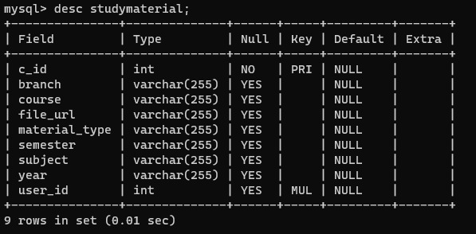
Technology Uses and Databases
Database
Table 1

Slide 11
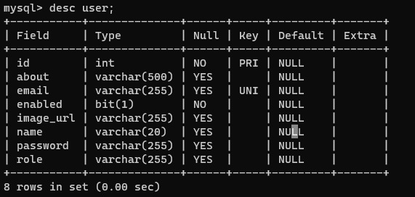
Technology Uses and Databases
Database
Table 2

Slide 12
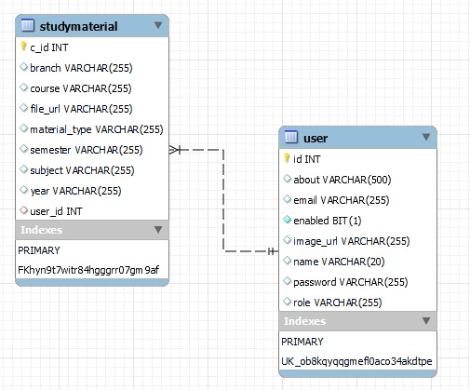
Technology Uses and Databases
Database
ER Diagram

Slide 13




Software and Server
Software
Eclipse
Spring Suite Tool
Visual Studio Code
MySQL Workbench

Slide 14


Software and Server
Software and Server
Git/GitHub
Tomcat Server

Slide 15

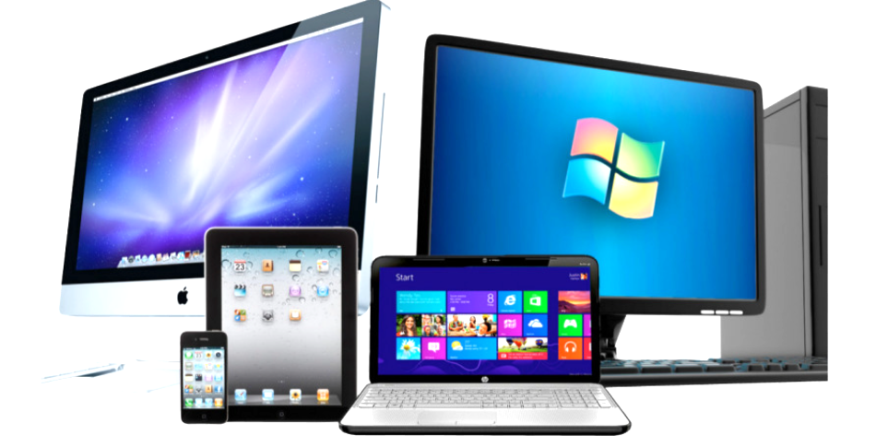
Supported Devices
IET DAVV STUDYMATERIALS are responsive website which is supported by any device which may be Laptop, Computer, Smart Phone (Android or IOS), Tablets etc.

Slide 16

System Requirements
Android User
Hardware Requirements
Ram:- Minimum 2GB
Memory:- Minimum 16GB
Software Requirements
OS:- Android 4.4.4 (KitKat) or higher

Slide 17

System Requirements
PC User
Hardware Requirements
Ram:- Minimum 2GB
Memory:- Minimum 500GB
Software Requirements
OS:-Linux/Windows/Mac

Slide 18
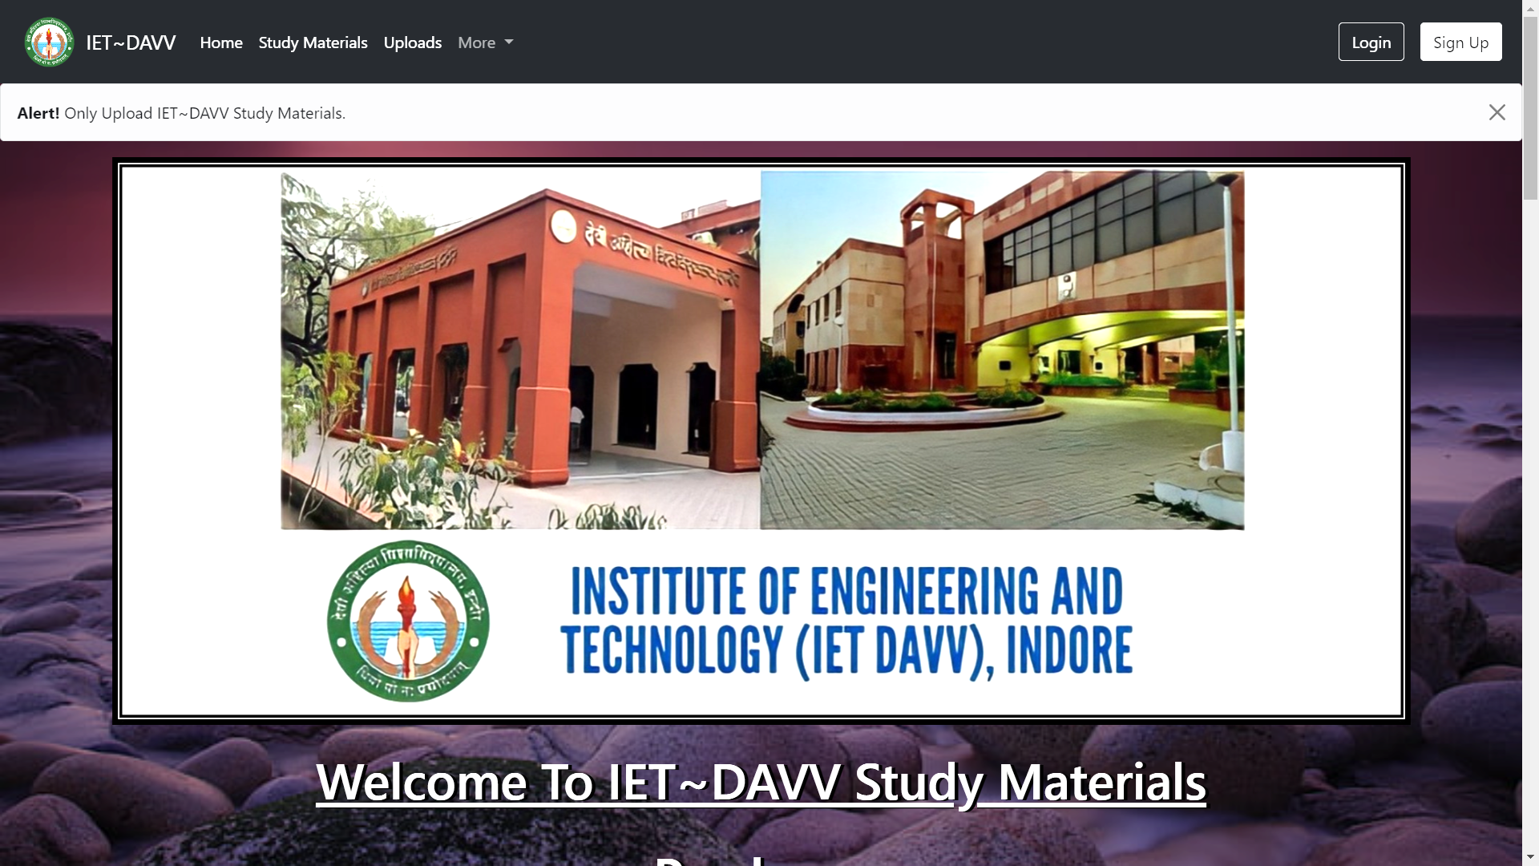
Screenshots and Explanation
Home Page

Slide 19
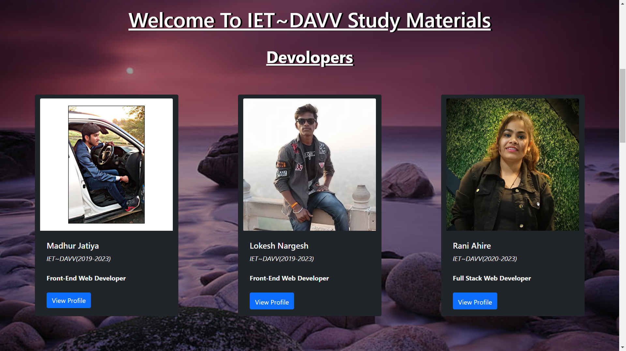
Screenshots and Explanation
Developers Page

Slide 20
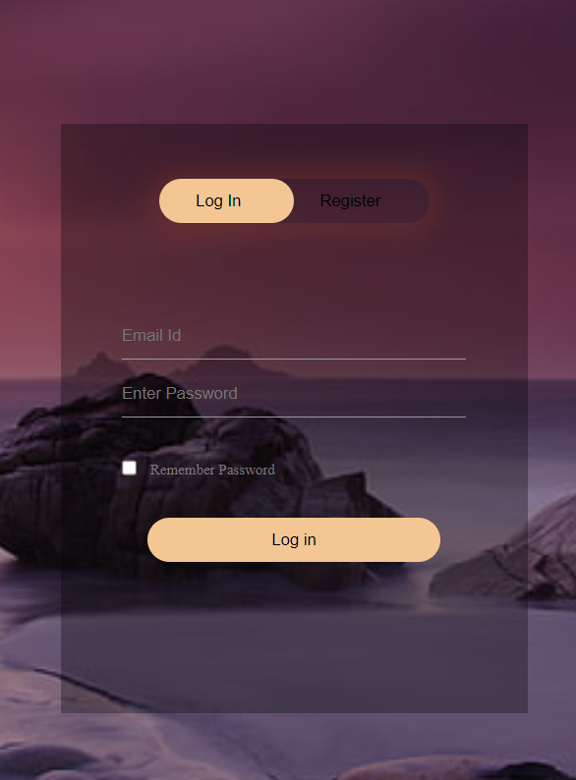
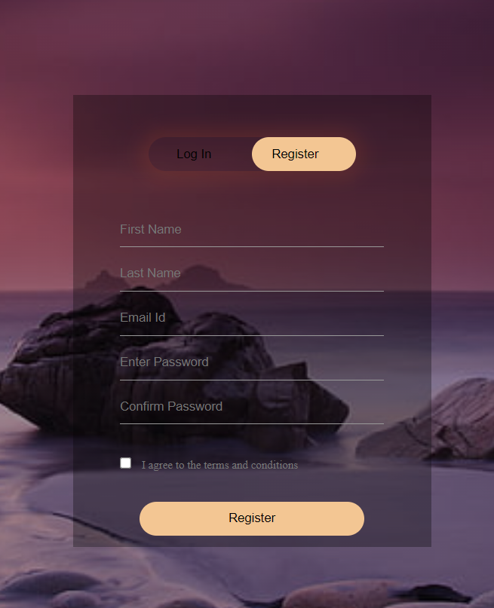
Screenshots and Explanation
Login & Signup Page

Slide 21
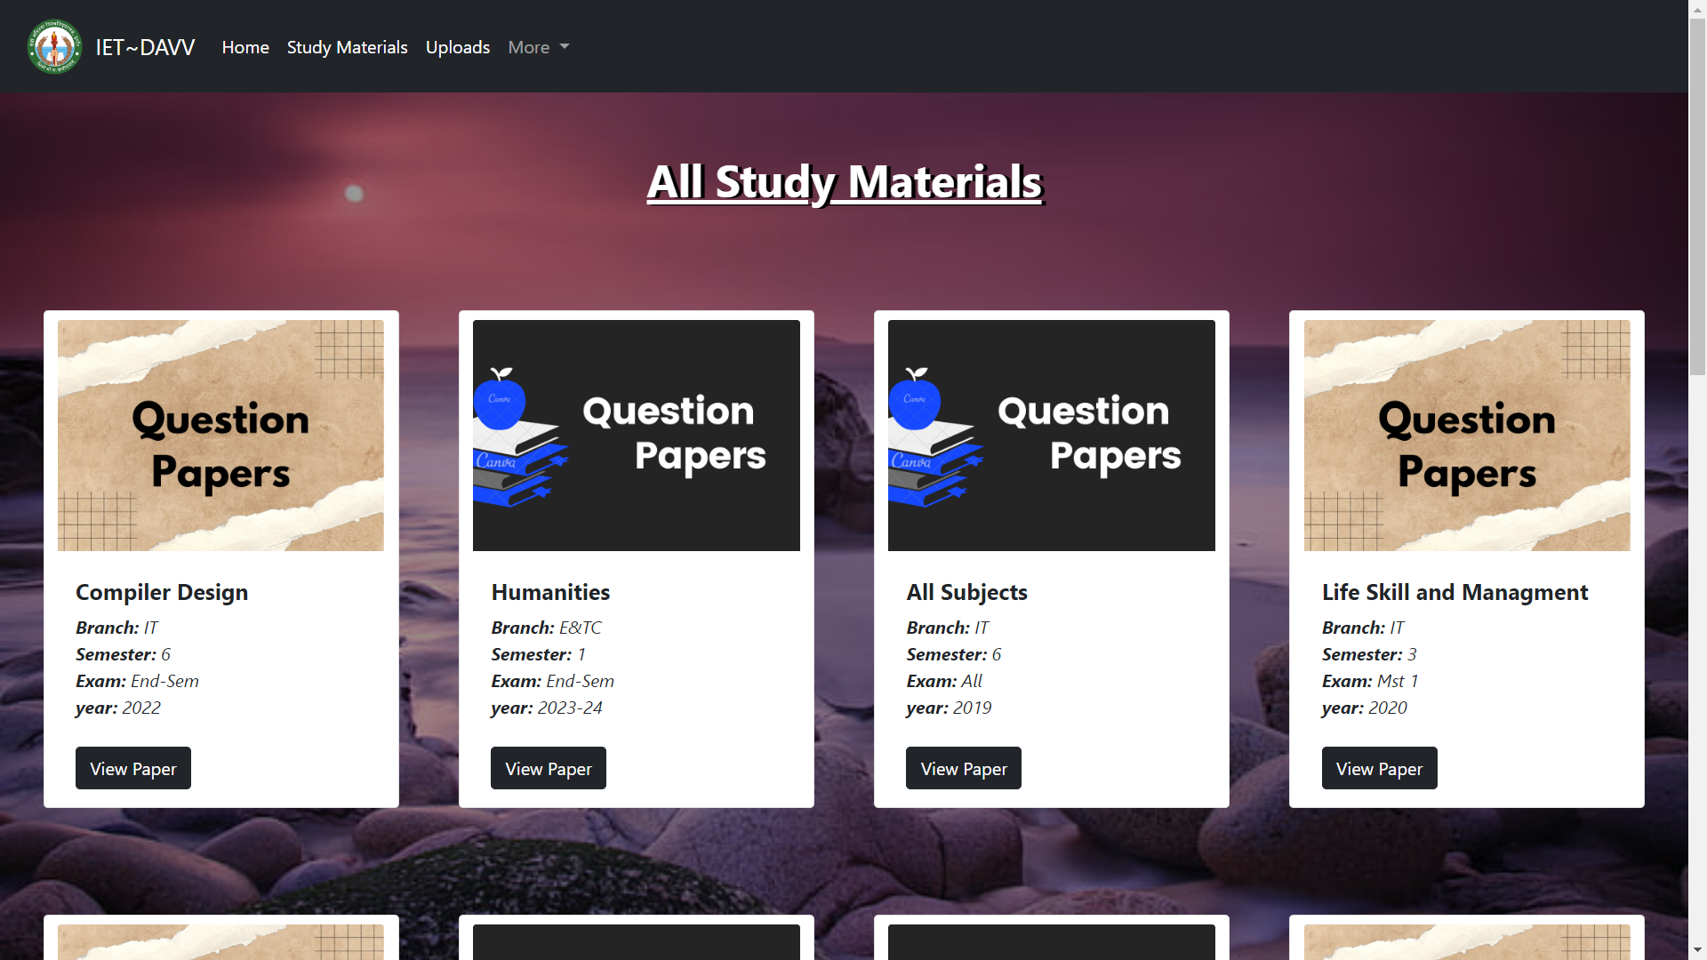
Screenshots and Explanation
View Study Materials

Slide 22
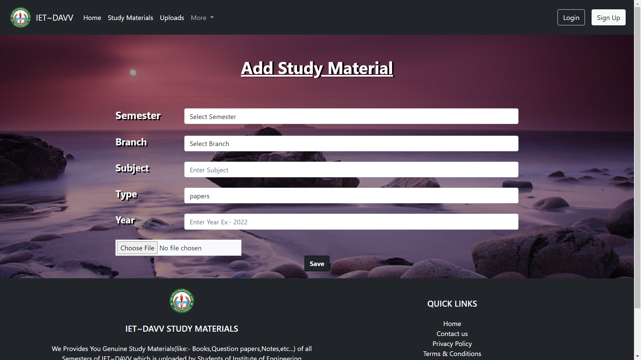
Screenshots and Explanation
Upload Study Materials

Slide 23
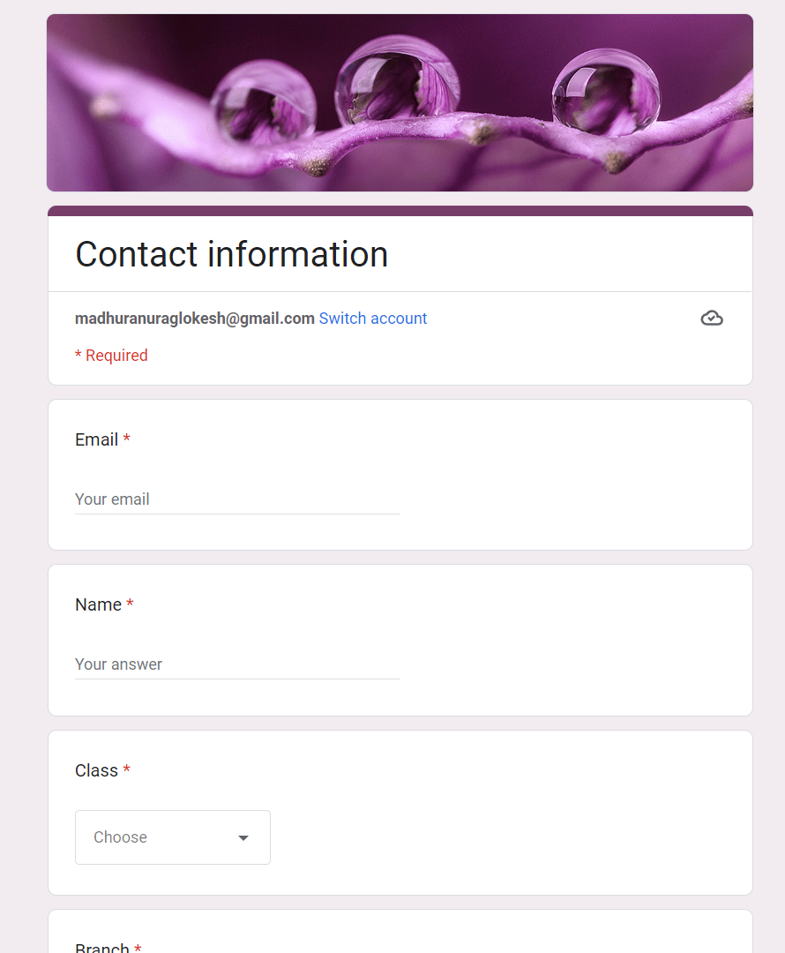
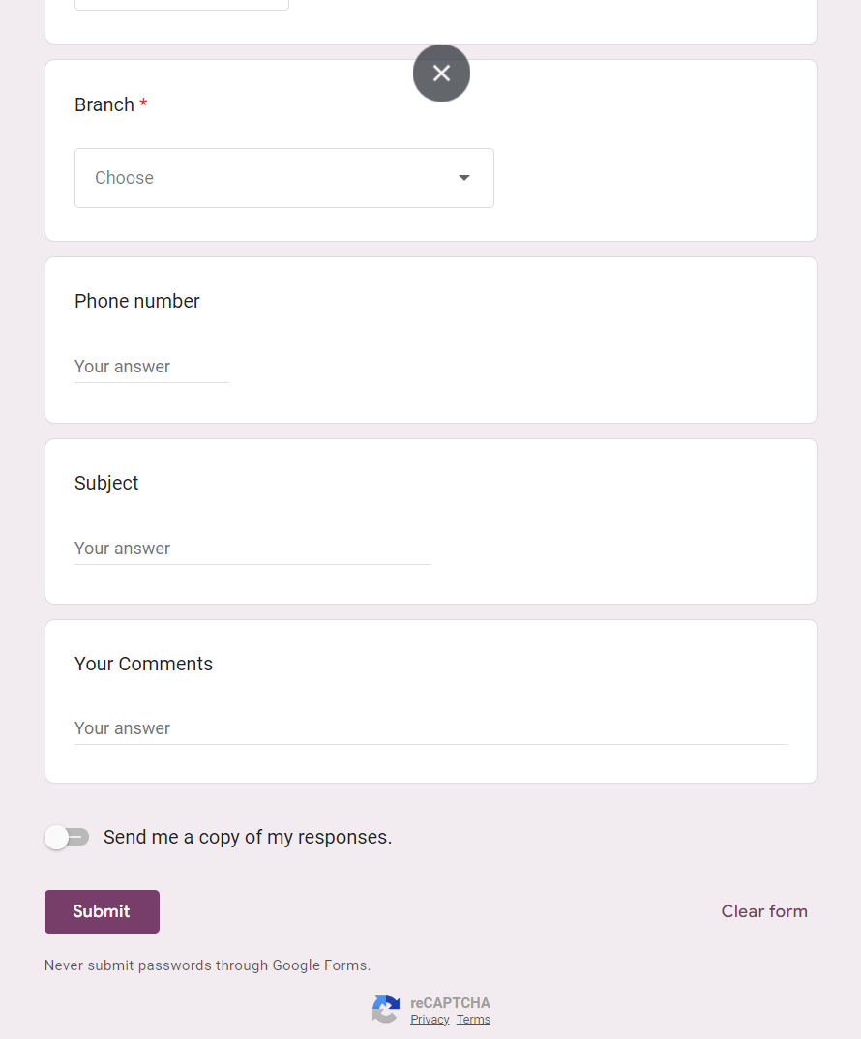
Screenshots and Explanation
Contact Us

Slide 24
References
1. LittleHelp (http://littlehelp3.epizy.com/index.php)
2. LetsPrep! (https://letsprep.co.in/)
3.RGPV Notes (https://www.rgpvnotes.in/btech/grading-system-old/notes/)
4.NPTEL (https://nptel.ac.in/courses)
5.SaiVidhya (https://saividya.ac.in/study-material-cse.html)

Slide 25

Thank You

